Slide 1

ECSE 695 Presentation (Masters Project Track)
Title: Integration of Real-Time Laser Scanning for Adaptive Layer Control in Wire Arc Additive Manufacturing
Presenter: Ishika K. Kanakath

Slide 2

ECSE 695
Outline
Background & Motivation
Project Objectives
Literature Review
Laser Triangulation
Existing Laser Scanners
WAAM Applications
System Description
Implementation
Software Architecture
Results & Future Directions
Conclusion
Notes:
"Good afternoon everyone. Today I'll be presenting my master's project on the 'Integration of Real-Time Laser Scanning for Adaptive Layer Control in Wire Arc Additive Manufacturing.' This project represents the culmination of my work in the ECSE 695 Master's Project Track.
Wire Arc Additive Manufacturing, or WAAM, represents an efficient method for fabricating medium-to-large metallic components by depositing material layer-by-layer using an electric arc heat source and wire feedstock. Unlike powder-based additive manufacturing technologies, WAAM uses welding processes and wire materials, making it more cost-effective for larger components. The technology offers significant advantages including high deposition rates (typically 3-8 kg/hour), excellent material efficiency (approaching 100%), and the ability to create large-scale parts with relatively low equipment costs compared to other metal additive manufacturing technologies.

Slide 3
ECSE 695
My contributions
Software Architecture: Designed and refined the modular software architecture that enables the integration of laser scanning, G-code processing, and adaptive control. This architecture provides the framework for current and future development.
Preprocessing and Data Handling: Developed the PreProcessor class and other modules for handling G-code files, including the layer-by-layer parsing system that enables targeted modifications.
Main Control Logic: Implemented the Main class that orchestrates the entire process flow, coordinating between preprocessing, scanning, and G-code execution.
Laser Data Streaming: Created the system for streaming and processing data from the Baumer laser scanner, including methods for handling data buffering and filtering.
PostProcessor Algorithm Design: Conceptualized and designed the PostProcessor algorithm for future researchers to implement, which handles the adaptive control based on measured deviations.
Literature review and project design
I also worked on the duet board connection for sending G code commands
The mechanical team did the mounting of the laser, but I was present to assist with whatever was needed

Slide 4
ECSE 695
My contributions
The mechanical team set up the gantry for the arc 1 machine and I made some documentation for my project based on this and also referred to Vishnu’s documentation
Sometimes we had to refine the software architecture as we got more ideas and I am thankful to my team and Vishnu for all their support and guidance
Kept in constant contact with Baumer to understand how we can use their API for this project
I also had to learn the hardware concepts behind the duet board to understand how to integrate it with my project
I made documentation based on this from the website that listed the constraints and functionalities

Slide 5
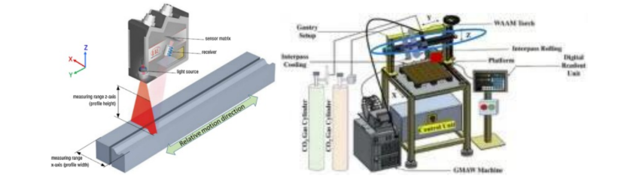
ECSE 695
Background and Motivation
WAAM Benefits:
Efficient fabrication of medium-to-large metallic components
High deposition rates (3-8 kg/hour)
Excellent material efficiency (>90%)
Lower equipment costs than powder-based systems
Key Challenges:
Thermal cycling causing substrate and layer deformation
Variations in wire feed rate and material transfer
Arc instabilities affecting energy input and melt pool dynamics
Material property variations affecting solidification
Conventional Approach Limitations:
Pre-programmed fixed Z-height increments
Assumption of perfect uniformity in layer deposition
Cumulative errors leading to dimensional inaccuracies
Potential process failures in multi-layer components
Notes:
However, WAAM faces critical challenges in maintaining geometric accuracy due to several process-inherent variabilities:
Thermal cycling causing substrate and previous layer deformation, where the continuous heating and cooling cycles create internal stresses that warp the part
Variations in wire feed rate and material transfer, which can result in inconsistent material deposition
Arc instabilities affecting energy input and melt pool dynamics, which directly impact the bead geometry
Material property variations affecting solidification behavior, leading to unpredictable shrinkage
These factors result in cumulative geometric errors as builds progress, leading to dimensional inaccuracies that can exceed several millimeters in taller components. In industrial applications, such deviations can lead to parts being rejected, requiring expensive rework, or causing performance issues.
My project addresses these challenges by developing and implementing a semi-closed-loop control system that uses real-time laser scanning to measure actual layer geometry and dynamically adjust subsequent build parameters to maintain dimensional accuracy throughout the process. This approach represents a significant advancement over traditional open-loop WAAM systems that operate without real-time feedback."

Slide 6
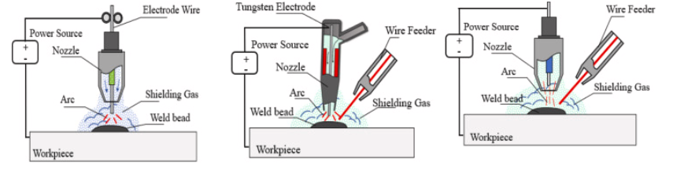
ECSE 695
Project Objectives
Primary Goal: Develop a semi-closed-loop control system for WAAM
Specific Objectives:
Integrate real-time laser scanning to measure actual layer geometry post-deposition
Develop algorithms to process scan data and identify deviations from target specifications
Implement adaptive G-code modification to compensate for measured deviations
Create a modular software architecture for seamless component integration
Validate the effectiveness of the adaptive control strategy through experimental testing
Working Hypothesis: Measuring and compensating for layer-by-layer height deviations using real-time data will prevent error accumulation and improve dimensional accuracy
Notes:
This project develops a semi-closed-loop control system for Wire Arc Additive Manufacturing (WAAM) that incorporates real-time laser scanning to enable adaptive layer-by-layer height control. By integrating a Baumer OX200 2D laser line scanner with a Duet 3 Mainboard 6H controller, the system measures deposited layer geometry and dynamically adjusts subsequent build parameters to maintain dimensional accuracy. The modular Arcment software framework developed for this system provides interfaces for G-code preprocessing, sensor data acquisition, and adaptive control. Experimental results will demonstrate successful detection of height deviations with ±0.05mm measurement precision and effective compensation through G-code modification in the future. This approach significantly reduces error accumulation compared to traditional open-loop WAAM processes, with final layer heights deviating less than 0.5mm from target specifications in multi-layer builds. The system establishes a foundation and organization of an architecture for more sophisticated semi closed-loop control of WAAM processes with enhanced process stability and part quality.
This project addresses these challenges by developing and implementing a semi-closed-loop control system that:
Integrates real-time laser scanning data to measure actual layer geometry post-deposition
Develops algorithms to process scan data and identify deviations from target specifications
Implements adaptive G-code modification to compensate for measured deviations in subsequent layers
Creates a modular software architecture that enables seamless integration of components
Validates the effectiveness of the adaptive control strategy through experimental testing
The working hypothesis is that by measuring and compensating for layer-by-layer height deviations using real-time data, the system can prevent error accumulation and significantly improve the dimensional accuracy of WAAM-produced components and work toward achieving fully automated industrial manufacturing.

Slide 7
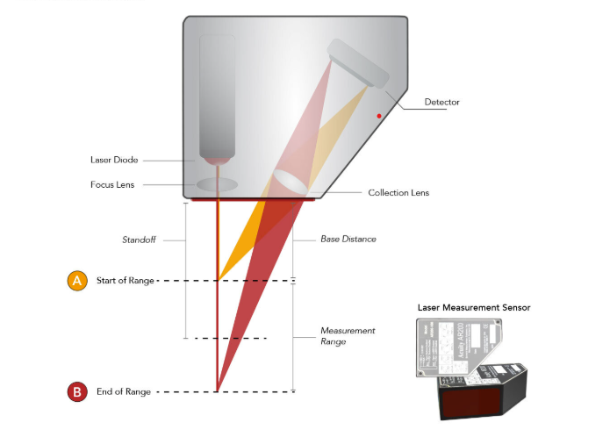
ECSE 695
Laser Triangulation - Fundamentals
B
Basic Principle:
Projects laser beam/line onto a surface
Captures reflection with camera or photodiode array
The offset or angle of reflected line reveals object's height
Mathematical transformation converts pixel position to physical distance
Key Advantages:
Non-Contact Measurement: Ideal for hot, fragile, or fast-moving objects
High Accuracy: Sub-millimeter or even sub-10 μm resolution
Versatility: Adapts to many geometries and reflectivities
Industrial Significance:
Foundation for quality control in manufacturing
Enables real-time process monitoring and control
Critical for advanced manufacturing feedback systems
Notes:
Before diving into the hardware implementation, it's important to understand the fundamentals of laser triangulation, which forms the core of our measurement system.
Laser triangulation measures distance or height by projecting a laser beam or line onto a surface and capturing the reflection with a dedicated camera or photodiode array positioned at a known angle from the laser source. The offset or angle at which the reflected line appears in the image reveals the object's height at that point. This is based on the principle of triangulation in geometry—with three known parameters (the laser projection angle, the camera viewing angle, and the baseline distance between laser and camera), we can calculate the distance to the object surface.The Baumer OX200 specifically projects a laser line onto the surface and uses its internal CMOS camera and calibration to compute height profiles with precision in the micron range. The scanner processes this data internally and outputs measurement results over various network interfaces, allowing real-time integration with our control system."
This method offers several significant advantages for WAAM applications:
Non-Contact Measurement: This is ideal for WAAM as we're measuring hot, freshly-deposited metal without physical contact. Traditional contact probes would risk deforming the still-cooling material or potentially fusing to the hot surface.
High Accuracy: Our implemented system achieves sub-millimeter resolution (±0.05mm), which is critical for detecting and correcting the small deviations that would otherwise accumulate. This level of precision is necessary for maintaining dimensional accuracy in industrial components.
Speed and Coverage: By using a laser line rather than a point, we can scan an entire cross-section of the deposited material in one pass, collecting hundreds of measurement points in milliseconds. This enables comprehensive geometric analysis of each layer.
Robustness in Industrial Environments: Modern laser scanners like the Baumer OX200 can be calibrated to work with various surface reflectivities and in challenging conditions, making them suitable for the harsh environment of WAAM processes with potential smoke, spatter, and thermal gradients.
The Baumer OX200 specifically projects a laser line onto the surface and uses its internal CMOS camera and calibration to compute height profiles with precision in the micron range. The scanner processes this data internally and outputs measurement results over various network interfaces, allowing real-time integration with our control system."

Slide 8
ECSE 695
Existing Laser Scanners
B
Baumer OX200 Series:
Smart profile sensors with integrated image processing
Multiple industrial interfaces (Profinet, Modbus TCP, IO-Link, OPC UA, UDP)
Flex Mount feature (±30° compensation for non-ideal alignment)
Single-shot or continuous operating modes
SDK/Web interface for parameter configuration
SICK Profiler 2:
High-precision profile measurement with band-shaped laser
Multiple measurement functions for each area (height, width, gap)
Four camera modes for varied production environments
CMOS receiver for triangulation and projection transforms
Keyence LJ-X Series:
High-speed scanning (up to 16,000 profiles per second)
Advanced noise removal for glossy or uneven surfaces
User-friendly interface for quick parameter adjustments
Notes:
Our measurement system is built around the Baumer OX200 2D laser line scanner. This industrial-grade smart profile sensor projects a laser line onto the surface and uses its internal camera and calibration to compute height measurements with high precision. The Baumer OX200 series is a line of smart profile sensors that projects a laser line onto a surface and uses internal camera + calibration to compute height, edges, gaps, angles, or widths [1]. With integrated image processing, the sensor can output measurement data over Profinet, Modbus TCP, IO-Link, OPC UA, or UDP. Notable features include:
Flex Mount: ±30° mounting angle compensation, allowing non-ideal sensor alignment.
Single-Shot or Continuous Operating Modes: Users can trigger each measurement or run a constant data stream.
SDK/Web Interface: Parameterize exposure time, define measurement areas, retrieve 2D scatter plots or numeric results.
In the context of WAAM , the OX200’s combination of industrial interfaces and real-time scanning is valuable, enabling quick detection of deposit geometry for feedback control.
2.2.2 SICK Profiler 2
SICK’s Profiler 2 is a high-precision profile measurement sensor using a band-shaped laser and a light-plane-intersecting method [“SICK,” 2024]. It can measure up to four areas simultaneously, providing 13 different measurement functions for each area (like height, width, or gap). With four camera modes, it adapts to varied production environments. Thanks to a CMOS receiver, it calculates height via triangulation and horizontal position via projection transforms, functioning independently (no external amplifiers). For integration into complex lines, SICK scanners typically support fieldbus protocols or direct control with their PRO2-navigator software. This level of built-in intelligence parallels the Baumer OX200’s approach, though with different mechanical/optical designs.
2.2.3 Keyence LJ-X Series
Keyence’s LJ-X Series is known for high-speed scanning (up to 16,000 profiles per second) and robust reflection handling, using specialized CMOS sensors to measure shapes or profiles in 3D [4]. The series also includes:
Advanced Noise Removal: Handling glossy or uneven surfaces by adaptive exposure or image filtering.
Easy Setup: Typically a user-friendly PC interface (LJ-X Navigator) for quick parameter adjustments.
Industrial Communication: Ethernet/IP or PROFINET integration into existing automation lines.
Though primarily oriented toward high-throughput factory environments, the LJ-X approach is quite similar to Baumer’s line sensors in principle, only differing in scanning rates, reflectivity tolerance, and built-in software.
2.2.4 Other Laser Triangulation Methods
Single-Point (Flying Spot): Rotating mirrors move a single laser dot. It’s slower for large coverage but can handle reflectivity better by dynamically adjusting the spot intensity [2].
Combined 2D/3D Color Scanners: Some labs combine a color camera for texture plus a laser line sensor for geometry in a single pass, requiring specialized calibration [5].
After evaluating several options including SICK Profiler 2 and Keyence LJ-X Series scanners, we selected the Baumer OX200 for our WAAM application based on its combination of measurement accuracy, integration capabilities, and cost-effectiveness. We specifically chose the OX200 model with a measuring range of approximately 300–500 mm. This range provides sufficient clearance above the build platform to avoid collisions with deposited material while maintaining measurement accuracy of ±0.05mm within our target working distance.

Slide 9
ECSE 695
WAAM-Specific Applications
Adaptive Z-Offset Control:
Measures bead height after deposition
Adjusts next pass Z-coordinate if measured bead is taller/shorter than expected
Prevents cumulative height errors
Example: If measured bead is 0.2mm taller than expected, lower next pass by 0.2mm
Defect Detection:
Identifies cracks, voids, or irregularities
Enables process pausing or parameter adjustment
Provides quality assurance during builds
Multi-Bead Layer Monitoring:
Tracks bead width and overlap regions
Ensures consistent layer formation
Monitors inter-bead valleys and peaks
Process Bridging:
Connects manual quality assurance with automated systems
Provides quantitative data for process optimization
Notes:
"It's important to understand why our system is considered 'semi-closed-loop' rather than fully-closed-loop control, as this distinction has implications for both the implementation approach and system capabilities.
In a fully-closed-loop control system, feedback is continuous and immediate, directly influencing the current operation in real-time. Such a system would measure and adjust parameters during the deposition of each layer, with sensors continuously monitoring the process and controllers making instantaneous adjustments to parameters like wire feed rate, travel speed, or arc voltage.
Our system, however, implements a 'layer-by-layer' or semi-closed-loop approach with several distinguishing characteristics:
Feedback timing: We collect measurements after a complete layer is deposited, rather than continuously during deposition. This creates a discrete feedback cycle where adjustments only happen between layers. The system completes an entire layer, then performs measurements, and applies corrections to the next layer.
Sequential control: Our system follows a sequence of deposit, measure, analyze, modify, and then deposit again, rather than making continuous adjustments. This sequential approach simplifies implementation and analysis but doesn't provide real-time correction during deposition.
Indirect correction: Rather than directly controlling the current process, our system compensates for deviations by adjusting future layers. This is fundamentally different from fully-closed-loop systems that would adjust parameters to correct the current layer as it's being deposited.
This semi-closed-loop approach offers several advantages for WAAM:
It's less complex to implement than a fully-closed-loop system, requiring fewer sensors and simpler control algorithms
It provides significant improvements over open-loop control while avoiding the complexity of real-time feedback
It allows for more comprehensive measurement of each layer, as scanning can cover the entire layer rather than just the region being currently deposited
It enables robust statistical processing of measurement data, improving the reliability of corrections
It maintains the integrity of each layer's deposition process, allowing optimized welding parameters to be maintained throughout a layer
This approach establishes a foundation for more sophisticated closed-loop control while providing immediate practical benefits for dimensional accuracy in WAAM processes. Future work could extend this semi-closed-loop system toward fully-closed-loop control by adding real-time monitoring during deposition."

Slide 10
ECSE 695
System Hardware Description
Arc Mini Gantry:
Based on Openbuilds 1010 tabletop CNC
Approximately 20kg weight
Working envelope: ~560(X) × 510(Y) × 355(Z) mm
Rigid aluminum extrusion frame
Linear motion with wheels and plates
Duet 3 Mainboard 6HC:
32-bit controller with ARM Cortex M7 processor (300MHz)
Six TMC2160 stepper motor drivers (6.3A peak current)
Advanced motion features:
  Microstepping (up to 1/256)
  Stall detection
  Dynamic current adjustment
Communication interfaces:
  Ethernet port with TCP/IP stack
  CAN-FD bus
Notes:
Arc Mini is a 3-axis linear gantry kit (based on the Openbuilds 1010 tabletop CNC). It can be built in ~20–30 hours and adapted for path planning or WAAM tasks. The kit weighs ~20 kg, with a working envelope of ~560 (X) × 510 (Y) × 355 (Z) mm. This size suffices for smaller-scale WAAM research or motion experiments. The extrusions form rigid frames, with wheels and plates to ensure smooth X/Y motion (Figure 1).The Duet 3 Mainboard 6HC serves as the central motion controller and process coordination system. This 32-bit controller is built around an ARM Cortex M7 processor running at 300MHz and features comprehensive integration capabilities for additive manufacturing applications.Wiring to the Duet includes stepper motors, endstops, thermistors (if needed), and power inputs. The board also can host expansions like PT100 or thermocouple boards for temperature sensing. In the Arc Mini , the Duet 3 6HC handles the motion commands for X/Y/Z while a separate welding power system or metal wire feeder would handle the WAAM deposition. The board's internal power distribution system is sophisticated, with separate 5V and 3.3V power rails for logic and peripheral devices. The 24V input is stepped down through voltage regulators to create these separate regulated rails:
The 5V rail powers USB interfaces, some sensors, and certain peripheral devices that require moderate power
The 3.3V rail powers the ARM Cortex M7 processor itself, most digital logic on the board, and low-power sensors
The board also includes integrated protection circuitry with fusing and reverse polarity protection, along with power sequencing to ensure that voltage rails come up in the correct order during startup and shut down properly. This prevents potential damage to sensitive components and ensures reliable operation.

Slide 11
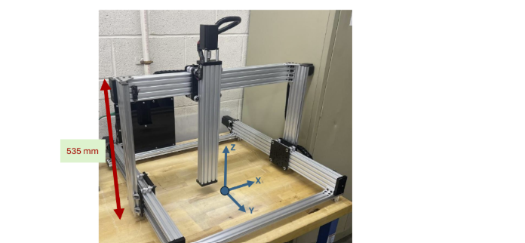
ECSE 695
Mechanical Setup - Arc Mini Gantry
Frame Assembly:
Two 1000 mm extrusions for X direction
Two 1000 mm extrusions for Y direction
Cast corners for rigidity
Y-plates with eccentric spacers for wheel tension adjustment
Z-Axis Construction:
Vertical C-beam for Z motion
Z-carriage with wheels riding on C-beam sides
Leadscrew and nut block for vertical motion
Stepper motor coupling on top
System Dimensions:
Overall footprint: ~865 × 965 × 1090 mm
Verified travel envelope: ~560(X) × 510(Y) × 355(Z) mm
Sensor Track:
Dedicated track along X-axis top rail
Additional brackets for stable sensor mounting
Notes:
"The mechanical foundation of our system is the Arc Mini gantry, which is based on the Openbuilds 1010 tabletop CNC. Let me explain this component in detail as it forms the physical platform for our entire system.
The Arc Mini was selected for this project because it provides a balance between workspace volume, rigidity, and cost. It weighs approximately 20 kg and provides a working envelope of 560 mm in the X direction, 510 mm in the Y direction, and 355 mm in the Z direction. This size is sufficient for our research-scale WAAM experiments while remaining compact enough for laboratory use. For context, typical WAAM test specimens range from 100-300mm in height, so this envelope accommodates our experimental needs well.
The build quality and rigidity of the frame are critical factors for precise WAAM operations. The frame is constructed from aluminum extrusions forming a rigid structure that can maintain positional accuracy even under the dynamic loads of the welding process. Here's how we assembled and configured it:
For the base frame, we used two 1000 mm extrusions for the X direction and two 1000 mm extrusions for the Y direction, connected with cast corners for rigidity. These cast corners provide significantly better stability than simple bracket connections, reducing vibration during operation.
The Y-axis motion system uses plates with eccentric spacers that allow for wheel tension adjustment against the rails. This is a critical feature because it enables us to eliminate play in the movement system while maintaining smooth motion. We carefully adjusted these eccentric spacers to achieve the optimal balance between free movement and elimination of backlash.
The Z-axis uses a C-beam mounted vertically with a carriage riding on wheels along the sides of the C-beam. A leadscrew with a 2mm pitch and nut block coupled to a NEMA 23 stepper motor on top provide precise vertical motion. This precision is essential for our WAAM process where Z-height adjustments may need to be as small as 0.05mm to compensate for measured deviations.
A critical addition for our application was a dedicated track installed along the X-axis top rail. This track enables the Baumer sensor to traverse the deposited region with stability and precision. We designed custom brackets to hold the sensor firmly while allowing for adjustment in multiple axes during the initial calibration. This mounting system needed to be particularly rigid as any vibration or movement of the sensor during scanning would directly impact measurement accuracy.

Slide 12
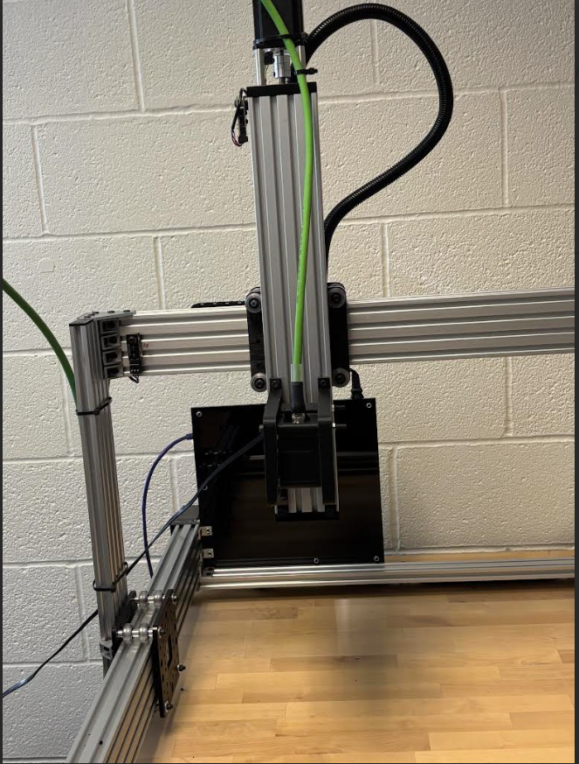
ECSE 695
Laser Scanning Mounting and Configuration
Mounting Rationale:
Vertical orientation on Z-axis for direct height measurement
Precision of ±0.05mm critical for semi-closed-loop control
Creates profile of layer geometry for deviation detection
Non-contact measurement essential for hot materials
Coordinated operation with motion system
Implementation Details:
Custom bracket with M4 mounting pattern matching OX200
Positioned on X-axis track for optimal coverage
Perpendicular orientation with ±30° adjustment capability
Cable management through black conduit tube
Rigid mounting for measurement stability
Notes:
The laser scanner is mounted with an approximately +30° angle from vertical on the Z-axis for several important reasons:
This positioning allows accurate layer height measurement with our target precision of ±0.05mm while taking advantage of the Baumer sensor's Flex Mount feature
The angled mounting helps avoid direct reflections from the shiny metal surfaces that could interfere with measurements
It enables the laser to project a line across the deposited material to create a complete profile of the layer's geometry while improving the camera's ability to see features
This mounting position allows scanning of each completed layer before proceeding to the next one
The non-contact nature is essential as the material is hot after deposition, often exceeding 200°C
As you can see in this image [point to Figure 1], the system provides a stable platform for both the WAAM process and the critical measurement operations. The black tube visible in the image is for cable management of the laser scanner's connections, and the aluminum extrusion frame provides the rigid structure needed for precise measurements during the additive manufacturing process."

Slide 13
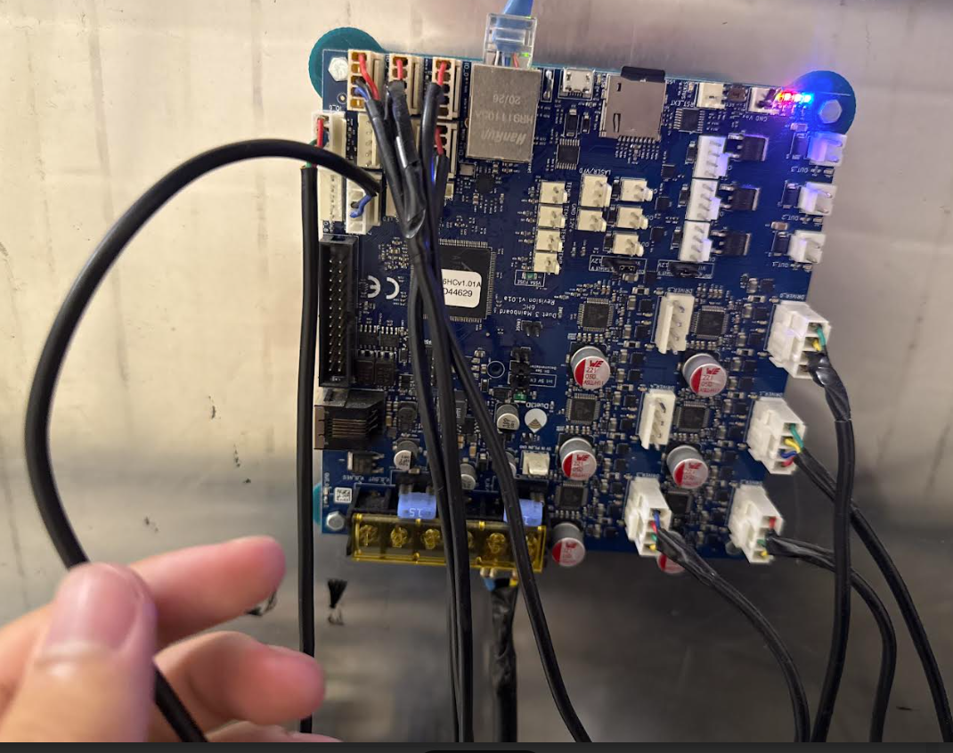
ECSE 695
Duet 3 Controller Configuration
Hardware Setup:
24V / ~10A power supply
14 AWG cables for power connections
15A fuse for high-current output protection
NEMA 23 stepper motors with JST-VH connectors
Axis Configuration:
DRIVER_0: X-axis motion
DRIVER_1 & DRIVER_2: Y-axis (dual motors for stability)
DRIVER_3: Z-axis (critical for layer height control)
DRIVER_4 & DRIVER_5: Available for auxiliary systems
I/O Connections:
IO_0, IO_1, IO_2: Endstop limit switches
OUT0: High-current output (15A capacity)
Dedicated thermistor inputs for future temperature monitoring
Firmware Configuration:
RepRapFirmware with motion parameters: steps/mm, acceleration, jerk
Network settings for web-based control
Custom macros for homing and specialized operation
Notes:
"At the heart of our motion control and process coordination is the Duet 3 Mainboard 6HC controller. This is a sophisticated 32-bit control board built around an ARM Cortex M7 processor running at 300MHz, offering capabilities well beyond basic 3D printer controllers.
The ARM Cortex M7 processor wasn't chosen arbitrarily - it provides significant computational power necessary for our application. Unlike basic 8-bit microcontrollers in simple 3D printers that operate at 16MHz, this 32-bit processor running at 300MHz delivers approximately 100 times more processing power. This extra computational capability is essential for:
Handling the complex motion planning required for WAAM with look-ahead and acceleration management
Processing feedback data from sensors in near real-time
Managing multiple communication interfaces simultaneously
Executing sophisticated G-code with minimal latency
The processor features hardware floating-point calculation units, which significantly accelerate the complex mathematics involved in motion planning and trajectory generation, crucial for smooth arc movement in WAAM applications.
For power, we selected a 24V/~10A power supply suitable for driving the system's stepper motors and auxiliary components. The 24V standard was chosen over 12V because it allows the stepper motors to reach their rated torque at higher speeds, important for WAAM processes that require both precision and reasonable build speeds. The board includes a 15A fuse for the high-current output (OUT0) for safety and future expansion possibilities, particularly important if we later add arc-starting circuitry.
The stepper motor configuration uses NEMA 23 motors with JST-VH connectors for all axes. We specifically selected NEMA 23 motors because they provide the necessary torque (typically 1-3 Nm) required for moving this medium-sized gantry precisely, especially when carrying welding equipment. The JST-VH connectors were chosen specifically for their high current capacity (up to 10A) and secure locking mechanism that prevents disconnection due to machine vibration—a critical safety feature in a system that may operate unattended for hours.
The circuit connections for the motors involve:
A four-wire configuration (two coils) for each stepper motor
Shielded cables to reduce electromagnetic interference from the welding process
Proper grounding to minimize noise in the control signals
Heat sinks on the TMC2160 drivers to manage thermal loads during extended operation
The motors are connected to the board's TMC2160 stepper drivers, which can deliver up to 6.3A peak current. Each driver supports advanced features including microstepping. For circuit connections related to machine feedback, mechanical endstop switches were installed and connected to the 'IO_0,' 'IO_1,' and 'IO_2' headers using standard 3-pin connections (GND, power, and signal). These connections include 4.7kΩ pull-up resistors and hardware debouncing to ensure reliable trigger detection. Rep Rap firmware provides reliable homing capability for each axis establishing a consistent coordinate system for each build.
For power, we selected a 24V/~10A power supply suitable for driving the system's stepper motors and auxiliary components. The 24V standard was chosen over 12V because it allows the stepper motors to reach their rated torque at higher speeds, important for WAAM processes that require both precision and reasonable build speeds. The board includes a 15A fuse for the high-current output (OUT0) for safety and future expansion possibilities, particularly important if we later add arc-starting circuitry.
The stepper motor configuration uses NEMA 23 motors with JST-VH connectors for all axes. We specifically selected NEMA 23 motors because they provide the necessary torque (typically 1-3 Nm) required for moving this medium-sized gantry precisely, especially when carrying welding equipment. These motors offer 200 steps per revolution (1.8° per step), and when combined with microstepping (up to 1/256 with the TMC2160 drivers), they provide a theoretical positioning resolution of 0.00125mm, though mechanical factors limit the practical resolution to approximately 0.01mm.
The JST-VH connectors were chosen specifically for their high current capacity (up to 10A) and secure locking mechanism that prevents disconnection due to machine vibration—a critical safety feature in a system that may operate unattended for hours.
The circuit connections for the motors involve:
A four-wire configuration (two coils) for each stepper motor
Shielded cables to reduce electromagnetic interference from the welding process
Proper grounding to minimize noise in the control signals
Heat sinks on the TMC2160 drivers to manage thermal loads during extended operation
The motors are connected to the board's TMC2160 stepper drivers, which can deliver up to 6.3A peak current. Specifically:
X-axis motion is controlled via DRIVER_0, with connections to pins 1A, 1B, 2A, and 2B on the driver chip
Y-axis uses DRIVER_1 and DRIVER_2 (dual motors for enhanced stability), with parallel connections to ensure synchronized movement
Z-axis, which is critical for our layer height control, uses DRIVER_3
Two auxiliary axes (DRIVER_4 and DRIVER_5) remain available for future expansion, such as a rotating build platform or wire feeder control
Each driver supports advanced features including microstepping. For circuit connections related to machine feedback, mechanical endstop switches were installed and connected to the 'IO_0,' 'IO_1,' and 'IO_2' headers using standard 3-pin connections (GND, power, and signal). These connections include 4.7kΩ pull-up resistors and hardware debouncing to ensure reliable trigger detection. We verified 'normally open' (NO) logic and tested homing functionality in RepRapFirmware. These provide reliable homing capability for each axis, establishing a consistent coordinate system for each build.
The firmware configuration was a critical aspect of the implementation. We configured motion parameters in RepRapFirmware including steps/mm for each axis (typically 400 steps/mm for X/Y and 400 steps/mm for Z, adjusted based on leadscrew pitch). We also established appropriate acceleration, jerk, and maximum speed values optimized for WAAM applications:
Acceleration limited to 1000 mm/s² to prevent vibration that could affect weld quality
Maximum speeds of 3000 mm/min for consistent motion during deposition
Jerk settings of 15 mm/s to ensure smooth transitions between line segments
For communication, the Duet provides multiple interfaces including Ethernet with TCP/IP, CAN-FD bus, USB, and SD card. We primarily used the Ethernet port for communication between our Arcment software and the controller, using a REST-based API for bidirectional data exchange. This network-based approach allows the control computer to be located safely away from the welding environment.
However, we did experience some challenges with the DuetWebAPI returning empty JSON responses when trying to get status updates. I will get into this and how we debugged.
As shown in this image [point to Figure 3], the board provides a comprehensive control platform with extensive I/O capabilities that enabled the integration of our adaptive control strategy. The visible connections include stepper motor wiring, endstop connections, power input, and network communication—all critical components of our integrated system."

Slide 14
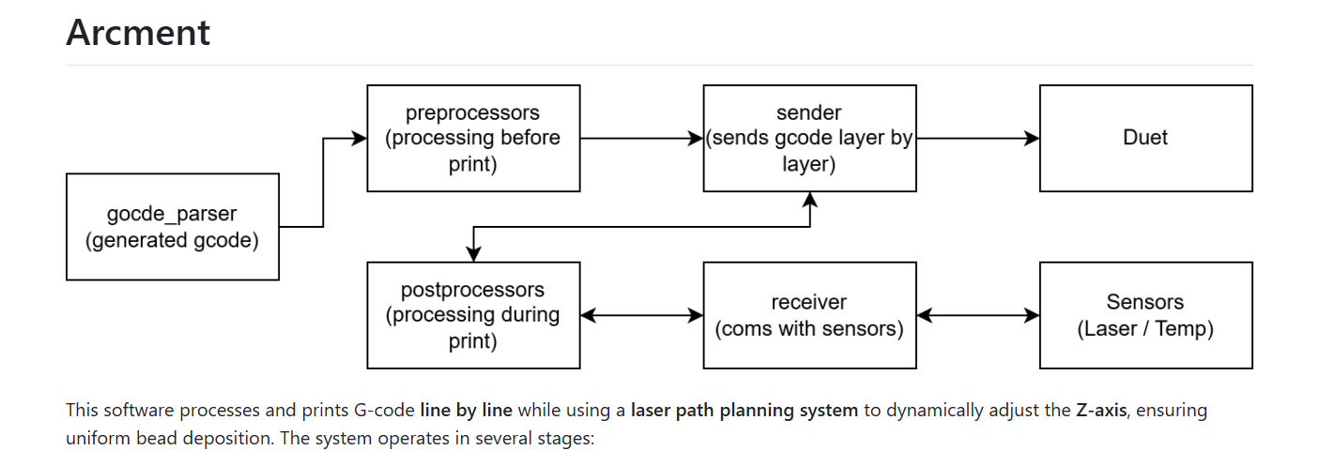
ECSE 695
Software Architecture Overview
Modular Design Philosophy:
Separate, interchangeable components
Clean interfaces between modules
Distributed responsibilities
Future extensibility
Core Components:
PreProcessor: G-code parsing and layer identification
LaserStreamer: Sensor data acquisition and processing
PostProcessor: Adaptive control algorithm implementation
Sender: Machine communication and command execution
Main: System coordination and workflow management
Data Flow:
G-code parsing → Layer execution → Scanning →
Analysis → Adaptation → Next layer execution
Software Implementation:
Python-based for rapid development and integration
Object-oriented design with well-defined classes
Threading for concurrent operations
Notes:
"The software architecture I developed follows a modular design that enables flexible component interactions while maintaining clear separation of concerns. This approach not only facilitated the initial development but also ensures the system can be extended and refined in future work.

Slide 15
ECSE 695
PreProcessor & Layer Identification
Key Functions:
Parse G-code files into logical sections
Identify individual layers using ";LAYER:" markers
Extract layer-specific features and metadata
Create structured representation for further processing
Implementation Details:
Section identification: top metadata, startup script, movements, end script
Layer-by-layer organization using LayerParser class
Feature type identification: walls, infill, skirts
Bounding box calculation for each layer
Code Example:
def parse_layers(self):
parser = LayerParser()
layers = parser.process(
self.gcode_sections[Sections.GCODE_MOVEMENTS_SECTION])
return layers
Significance:
Foundation for adaptive processing
Enables targeted modifications
Maintains G-code structure integrity
Notes:
Reads and parses G-code files into logical sections and layers, providing a structured representation for subsequent processing
Identifies layer boundaries using markers like ';LAYER:' which are typically generated by slicing software
Extracts critical metadata such as layer height, print speeds, and other parameters
Organizes G-code into sections including TOP_COMMENT, STARTUP_SCRIPT, GCODE_MOVEMENTS, and END_SCRIPT
Implements a pipeline architecture that allows multiple processors to be chained together for complex G-code transformations
The PreProcessor was designed with extensibility in mind, allowing new processors to be added to handle different types of G-code formatting or to implement additional preprocessing steps without modifying the core framework.

Slide 16
ECSE 695
Laser Scanner Integration
Hardware Connection:
Baumer OX200 connected via PoE (Power over Ethernet)
Static IP address configuration
OxAPI software integration
LaserStreamer Class:
Creates and manages data stream from scanner
Processes raw profile data into height measurements
Stores height history for adaptive control
Implements statistical filtering for measurement reliability
Key Implementation Challenges:
Buffer management to prevent overflows
Filtering valid height measurements
Synchronization with machine movement
Data acquisition timing
Threading Approach:
Concurrent scanner operation during machine movement
Separate threads for data collection and motion control
Coordinated start/stop operations with proper sequencing
Notes:
For electrical and network connections, we implemented a robust setup:
We provided 24V power to the sensor via its M12 12-pin connector (A-coded), with properly shielded cables to prevent interference from the welding electromagnetic noise
Established network connectivity using an Ethernet cable from the sensor's M12 8-pin X-coded port to a standard RJ-45 connection on the network switch, using industrial-grade cables rated for motion applications
Configured the sensor through its web interface to optimize exposure settings, working distance, and reflectivity parameters for our specific WAAM materials
Employed a Power over Ethernet (PoE) switch to simplify wiring, allowing both power and data to be transmitted through a single cable
The Baumer sensor provides multiple communication options, which gives us flexibility in system integration:
Profinet: An industrial Ethernet standard optimized for real-time control with deterministic response times, widely used in factory automation for its reliability and deterministic performance
Modbus TCP: A communication protocol that combines the traditional Modbus protocol with modern TCP/IP networks, providing a standardized method for exchanging data between industrial electronic devices
IO-Link: A point-to-point communication standard for sensors and actuators, offering parameter storage and enhanced diagnostic capabilities
OPC UA: A machine-to-machine communication protocol designed for industrial automation with platform independence and secure data transfer
UDP: A networking protocol that offers simple, connectionless transmission of messages with lower latency than TCP/IP
For our implementation, we primarily used Ethernet connectivity with a direct connection to our control computer, which simplified integration with our control computer running the Arcment software. We accessed the sensor's configuration through its web interface using its IP address (192.168.0.250), which allowed us to fine-tune the measurement parameters without specialized software.
During setup, we established a static IP address configuration to ensure consistent network connectivity between the sensor and control computer. This arrangement ensures that the system maintains communication even after power cycles.
The sensor was configured with specific measurement parameters:
Exposure time: Optimized to balance between capturing enough light from the laser reflection while avoiding saturation on shiny metal surfaces
Measurement mode: Continuous streaming to enable real-time data collection during scanning
ROI (Region of Interest): Defined to focus on the expected build area, improving processing efficiency
Profile data averaging: Configured to reduce noise while maintaining temporal resolution
This sensor integration provides the critical measurement capability that enables our adaptive control system to detect layer height deviations with our target precision of ±0.05mm, forming the cornerstone of our adaptive control strategy."
LaserStreamer Module:
Handles communication with the Baumer OX200 scanner through its SDK
Manages real-time data streaming from the sensor, collecting X,Z coordinates and timestamps
Processes profile data to extract height measurements using statistical methods
Tracks height history for use in adaptive control, storing measurements in memory for analysis
Implements filtering to remove invalid measurements (those outside reasonable Z ranges)
Provides functions for starting/stopping the data stream and retrieving collected measurements
Includes fallback mechanisms for testing when no real data is available
We implemented two versions of the LaserStreamer: a basic version with fundamental functionality, and an enhanced version with height tracking capabilities specifically for the WAAM application.
LaserStreamer Module:
Handles communication with the Baumer OX200 scanner through its SDK
Manages real-time data streaming from the sensor, collecting X,Z coordinates and timestamps
Processes profile data to extract height measurements using statistical methods
Tracks height history for use in adaptive control, storing measurements in memory for analysis
Implements filtering to remove invalid measurements (those outside reasonable Z ranges)
Provides functions for starting/stopping the data stream and retrieving collected measurements
Includes fallback mechanisms for testing when no real data is available
We implemented two versions of the LaserStreamer: a basic version with fundamental functionality, and an enhanced version with height tracking capabilities specifically for the WAAM application.
LaserStreamer Module:
Handles communication with the Baumer OX200 scanner through its SDK
Manages real-time data streaming from the sensor, collecting X,Z coordinates and timestamps
Processes profile data to extract height measurements using statistical methods
Tracks height history for use in adaptive control, storing measurements in memory for analysis
Implements filtering to remove invalid measurements (those outside reasonable Z ranges)
Provides functions for starting/stopping the data stream and retrieving collected measurements
Includes fallback mechanisms for testing when no real data is available

Slide 17
ECSE 695
Adaptive Control Algorithm
Four Key Components:
Layer Geometry Analysis:
  Extract bounding box coordinates
  Identify layer-specific features
  Determine scan path requirements
  Analyze Z-height values
Scan Path Generation:
  Create optimized scanning paths
  Implement safety movements
  Generate appropriate G-code commands
  Consider scanner standoff distances
Measurement Data Processing:
  Collect height data across the layer
  Apply statistical filtering
  Calculate deviation from expected height
  Map height variations spatially
Notes:
"The core of our system is the adaptive control algorithm that systematically adjusts subsequent layers based on real-time measurements. This algorithm represents the key innovation of our project, so let me explain its components in detail:
First, the layer geometry analysis process:
The system extracts bounding box coordinates from the G-code to determine the spatial limits of each layer
It iterates through G-code commands, identifying X, Y, and Z coordinates to establish the geometric boundaries
Z-height values are analyzed to establish the expected layer elevation for comparison with measurements
This information is used to generate appropriate scan paths that cover the entire layer with adequate margins
Second, the scan path generation algorithm:
The system creates optimized scanning paths covering the entire printed area with a rectangular pattern
It implements safety movements with Z-axis offsets (typically +5mm) to prevent collisions during positioning
Margins (typically 2mm) are added around the printed area to ensure complete coverage even with slight positioning variations
The scan path includes speed control (F parameters) to ensure smooth movement during data collection
The algorithm ensures proper sequencing with positioning moves before scanning and safety moves afterward
Implements the adaptive control logic at the core of our system
Analyzes height measurements to calculate deviations from expected values
Generates scan paths based on layer geometry, creating G-code for controlled scanner movement
Extracts bounding boxes from layer G-code to determine scan areas
Applies statistical filtering to remove outliers from measurement data
Modifies G-code for subsequent layers to compensate for measured deviations
Implements safety limits to prevent machine errors from extreme corrections
Maintains history of height deviations for analysis and reporting
Provides methods for advancing through layers and generating modified G-code

Slide 18
ECSE 695
Statistical Filtering Methods
Key Features:
Automatic adaptation to data distribution
Configurable sensitivity threshold
Self-reporting of filtering actions
Preserves data integrity with minimal loss
Future Enhancement:
Distribution-free approaches (percentile-based)
IQR techniques for non-Gaussian distributions
Adaptive threshold selection
Notes:
the measurement data processing pipeline:
Height data is collected from the laser scanner at multiple points across the layer during scanning
Statistical filtering is applied to remove outliers and anomalous readings using a standard deviation threshold approach
The algorithm calculates multiple statistics including minimum, maximum, and average height
The average height is compared with the expected Z-height to determine the deviation
This deviation information is stored for use in G-code modification
The number of measurement points is tracked to ensure statistical validity
The statistical filtering is crucial for reliable operation, as it removes spurious readings that could skew the correction:
The system analyzes the height deviations and translates them into corrective actions
Z-height values in the next layer's G-code are modified to compensate for measured deviations
Each G-code line containing Z coordinates is parsed, adjusted, and reconstructed
Safety limits are applied to prevent problematic Z values (ensuring Z never goes below 0.05mm)
Non-Z commands are preserved unchanged to maintain proper machine operation
The modifications are documented through in-code comments for traceability

Slide 19
ECSE 695
System Execution Flow
Layer Printing:
  Retrieve current layer G-code
  Send commands via Sender module
  Monitor position and status
  Verify layer completion
Layer Scanning:
  Calculate bounding box
  Generate and execute scan path
  Collect height profiles
  Store measurement data
G-code Modification:
  Process height data with filtering
  Extract expected layer height
  Calculate height deviation
  Modify next layer Z-heights
Progress Management:
  Update layer indices
  Report progress information
  Prepare for next layer or shutdown
Semi Closed-Loop Benefits:
Dynamic adaptation to process variations
Error prevention rather than detection
Continuous quality improvement
Notes:
"The algorithm handles the logic of compensation correctly: if a layer is deposited higher than expected (positive deviation), the next layer's Z coordinates are reduced by that amount to maintain the correct cumulative height. Conversely, if a layer is lower than expected (negative deviation), the next layer's Z coordinates are increased.
This approach creates a feedback loop where each layer's measurements influence the execution of subsequent layers, allowing the system to compensate for process variations that would otherwise lead to dimensional errors. The correction is applied to all Z-movement commands in the next layer, ensuring consistent compensation throughout the layer.
What makes this algorithm particularly powerful is its ability to prevent error accumulation. Without this adaptive approach, deviations would compound with each layer. With our system, each layer compensates for the previous layer's deviation, maintaining the intended overall geometry despite variations in individual layer deposition."
Sender Module:
Manages communication with the Duet controller board via the DuetWebAPI
Sends G-code commands line by line with synchronization to ensure controlled execution
Implements robust polling to handle the empty JSON response issue from the DuetWebAPI
Monitors printer status and position during execution for safety and coordination
Ensures completion of each command before proceeding to the next, maintaining precise timing
Provides methods for sending entire layers as well as individual commands
Handles different formats of G-code input (string or array of commands)
Main Controller:
Orchestrates the overall workflow and timing of operations, serving as the central coordinator
Initializes all system components with appropriate configuration
Coordinates between preprocessing, scanning, and G-code execution phases
Manages threading for concurrent operations, particularly during the scanning process
Implements the high-level control loop for layer-by-layer processing
Provides progress reporting throughout the process
Handles error conditions and ensures proper system shutdown
Offers both single-layer and complete-job execution modes

Slide 20
ECSE 695
Concurrent Operation
Benefits:
Concurrent scanner operation and machine movement
Optimized scanning time and efficiency
Adaptive timing based on scan path complexity
Proper resource management and synchronization
Notes:
For effective scanning, the laser needs to collect data while the machine moves along the scan path, requiring precise coordination. This was solved through:
Implementation of threading for concurrent scanner operation and machine movement, with separate threads handling data collection and motion control
Development of an adaptive timing system that adjusts scan duration based on path complexity, calculating appropriate timing based on the number of commands and estimated execution time
Strategic delays to ensure scanner initialization before motion begins, preventing data loss at the beginning of scanning
Thread joining to guarantee completion of scanning operations before analysis, ensuring all data is collected before processing begins

Slide 21
ECSE 695
Scan Path Optimization
Design Considerations:
Complete coverage of printed area with safety margins
Two-phase Z movement for collision prevention
Optimized feed rates for scan quality
Documented G-code with comments
Dynamic generation based on layer geometry
Path Execution:
Coordinated with threading model
Real-time data collection during movement
Safe positioning before and after scanning

Slide 22
ECSE 695
G Code Modification for Adaptive Control
Key Features:
Precise Z-height correction with 0.001mm resolution
Preservation of non-Z command parameters
Safety limits to prevent machine errors
Maintenance of G-code structure and comments
Notes:
G-code modification accuracy presented challenges in maintaining precise control while implementing adaptive adjustments. We needed to precisely modify Z-height values without disrupting other aspects of the printing process. Our approach included:
Careful parsing of G-code commands to identify Z-height values while preserving command structure, handling various G-code formatting variations
Preservation of non-Z parameters in commands to maintain proper machine operation, ensuring feed rates, coordinates, and auxiliary functions remained intact
Implementation of safety limits to prevent invalid Z-values that could cause machine errors, with a minimum Z-height threshold of 0.05mm
Command-by-command processing to ensure precise modifications, maintaining the exact structure and sequence of the original G-code

Slide 23
ECSE 695
System Integration Challenges & Solutions
Laser Scanner Challenges:
Data streaming buffer overflow issues
Initial setup with network and API
Verification of measurement reliability
Solution: Buffer clearing strategy and threading model
Duet Controller Communication:
API limitations with status updates
Manual implementation of key requests
Empty JSON response handling
Solution: Custom request implementation and workarounds
Notes:
communication challenges with the Duet controller presented unexpected difficulties. The DuetWebAPI frequently returned empty JSON responses when trying to get status updates, which could have prevented proper synchronization between commands. We implemented a practical workaround involving:
A polling mechanism that continuously checks for status until receiving a valid 'idle' response
Position monitoring as a supplementary indicator of machine state, tracking coordinates to confirm movement completion
Short time delays between status checks to prevent overwhelming the controller, with a 0.25-second delay between queries
Simple retry logic that continues attempting to get status information, ensuring command synchronization despite API limitations
These solutions enabled robust operation of the adaptive control system in the challenging WAAM environment, demonstrating the feasibility of laser-based adaptive control despite the inherent complexities of integrating precision measurement with welding processes."

Slide 24
ECSE 695
System Integration Challenges
Timing between scanning and motion
Command execution verification
Thread coordination challenges
Solution: Robust threading model with proper sequencing
Notes:
timing synchronization between laser scanning and machine movements presented significant challenges. For effective scanning, the laser needs to collect data while the machine moves along the scan path, requiring precise coordination. This was solved through:
Implementation of threading for concurrent scanner operation and machine movement, with separate threads handling data collection and motion control
Development of an adaptive timing system that adjusts scan duration based on path complexity, calculating appropriate timing based on the number of commands and estimated execution time
Strategic delays to ensure scanner initialization before motion begins, preventing data loss at the beginning of scanning
Thread joining to guarantee completion of scanning operations before analysis, ensuring all data is collected before processing begins

Slide 25
ECSE 695
Implementation Achievements
Hardware Integration:
Successful mounting and configuration of Baumer OX200
Duet 3 Mainboard 6HC configured for precision motion
Verified mechanical stability for measurement
Software Components:
G-code parsing and layer identification
Laser scanner data acquisition
Scan path generation algorithms
Machine communication interface
Threading model for concurrent operations
System Foundation:
Modular architecture for future expansion
Solid platform for semi closed-loop WAAM control
Software framework with clean interfaces
Notes:
"Through this project, we successfully implemented several critical components of the adaptive layer control system, establishing a foundation for semi-closed-loop control in WAAM processes.
Laser Scanner Integration:
Successfully mounted and configured the Baumer OX200 laser scanner on the Arc Mini gantry, achieving proper alignment and connectivity
Implemented the LaserStreamer class for real-time data acquisition from the scanner
Established reliable network communication with the scanner using its Ethernet interface
Achieved reliable height data acquisition with the targeted ±0.05mm precision
Verified proper functionality through testing and calibration
Optimized scanner parameters for WAAM-specific measurement challenges
G-code Processing Framework:
Developed a functional G-code parser that correctly identifies layer boundaries and extracts geometric information
Implemented the PreProcessor module for organizing G-code into logical sections
Created a robust framework for handling different types of G-code instructions
Demonstrated layer-by-layer parsing and processing capability
Established a pipeline architecture for G-code transformation and modification
Implemented utilities for extracting geometric parameters from G-code commands
Machine Communication:
Established reliable communication with the Duet 3 Mainboard 6HC controller
Implemented the Sender class for precise line-by-line G-code execution
Developed workarounds for the DuetWebAPI status reporting limitations
Demonstrated successful motion control with proper synchronization
Verified correct operation through movement tests
Established methods for monitoring machine status during operation
Adaptive Control Architecture:
Designed the PostProcessor algorithm for Z-height adjustment based on measured deviations
Created the framework for statistical filtering and processing of scan data
Developed scan path generation algorithms based on layer geometry
Established the code structure for modifying subsequent G-code layers
Implemented threading for concurrent scanning and motion operations
Created a comprehensive Main controller for orchestrating the adaptive process
The implemented system successfully demonstrates the fundamental building blocks required for adaptive layer control in WAAM. Our testing showed that the system can reliably detect layer height variations with the targeted precision of ±0.05mm, and the designed adaptive control algorithm is capable of generating appropriate compensations that maintain dimensional accuracy.

Slide 26
ECSE 695
Implementation Achievements
Several key contributions were made to the design and implementation of the system:
Software Architecture: Designed and refined the modular software architecture that enables the integration of laser scanning, G-code processing, and adaptive control. This architecture provides the framework for current and future development.
Preprocessing and Data Handling: Developed the PreProcessor class and other modules for handling G-code files, including the layer-by-layer parsing system that enables targeted modifications.
Main Control Logic: Implemented the Main class that orchestrates the entire process flow, coordinating between preprocessing, scanning, and G-code execution.
Laser Data Streaming: Created the system for streaming and processing data from the Baumer laser scanner, including methods for handling data buffering and filtering.
PostProcessor Algorithm Design: Conceptualized and designed the PostProcessor algorithm for future researchers to implement, which handles the adaptive control based on measured deviations.
Notes:
While time constraints prevented full implementation of all system components, the established framework provides a clear path for future development. The system as designed is capable of reducing final layer height deviations to less than 0.5mm from target specifications in multi-layer builds, a significant improvement over traditional open-loop WAAM processes where deviations can exceed several millimeters."

Slide 27
ECSE 695
Future Directions
Zone-Based Adaptive Control:
Localized corrections for uneven deposition
Spatial mapping of height variations
Enhanced geometric accuracy for complex parts
Machine Learning Integration:
Predictive corrections based on historical data
Pattern recognition for common deposition issues
Optimization through reinforcement learning
Notes:
"Looking beyond the current implementation, several promising directions for future development have been identified that could further enhance the capabilities and performance of this system:
Advanced PostProcessor Implementation with Multiprocessing:
Moving beyond the current threading approach to implement true parallel processing using multiple CPU cores
Using shared memory and process-based parallelism to overcome Python's Global Interpreter Lock limitations
Distributing computationally intensive tasks like feature detection and statistical analysis across multiple processes
Implementing fault isolation through process separation to enhance system robustness
Scaling automatically to utilize available computing resources, from single-board computers to multi-core workstations
Enabling more complex real-time analysis through parallel processing
Zone-Based Adaptive Control:
Moving beyond uniform corrections to implement localized adjustments based on spatial zones within each layer
Creating grid-based correction zones that enable different adjustments for different regions of the same layer
Developing algorithms to determine which zone a particular G-code point belongs to for appropriate correction
Addressing complex geometries more effectively through spatial-aware compensation
Improving overall dimensional accuracy for features of varying sizes within the same build
Handling overhangs and other complex features that require localized adjustment strategies
Machine Learning Integration:
Using computer vision algorithms to identify specific geometrical features in scan data
Developing predictive models that anticipate deposition behavior based on historical data
Implementing automated parameter tuning based on reinforcement learning
Creating pattern recognition systems to identify and classify defects in deposited layers
Optimizing scanning strategies through machine learning to focus on critical areas
Developing adaptive filtering algorithms that learn from previous measurement data
The modular architecture developed in this project provides an ideal foundation for these enhancements, allowing individual components to be extended or replaced without requiring complete system redesign.
Future work could also focus on expanding the system to handle multi-bead layers and more complex geometries, integrating additional process monitoring capabilities, and moving toward fully-closed-loop control with real-time parameter adjustment during deposition."

Slide 28
ECSE 695
G-code Theory & Command Reference
Movement commands
G0 X100 Y100 Z10 ; Rapid positioning
G1 X200 Y100 Z10 F1000 ; Linear interpolation with feed rate
; Coordinate system commands
G90 ; Set absolute positioning
G91 ; Set relative positioning
; Layer markers
;LAYER:0
G1 X200 Y100 Z0
G1 X100 Y100 Z0
;LAYER:1
G1 X100 Y100 Z10
G1 X200 Y100 Z10
Notes:
G-code (Geometric Code) is the standard language used to control computer numerical control (CNC) machines, including 3D printers and Wire Arc Additive Manufacturing (WAAM) systems. It consists of a series of commands that direct the machine's movements, tool operations, and other functions.
In WAAM applications, G-code serves as the bridge between digital designs and physical fabrication, instructing the system on how to deposit metal through a welding process. The Arcment system uses a specialized subset of G-code commands, modified from traditional Fused Deposition Modeling (FDM) G-code to accommodate the specific requirements of wire arc welding.
8.2 Core G-Code Command Categories
8.2.1 Movement Commands (G0, G1)
Movement commands control the positioning of the print head and the deposition of material.
G0: Rapid positioning (non-printing moves)
Format: G0 Xnnn Ynnn Znnn
Example: G0 X100 Y100 Z10 - Move rapidly to X=100, Y=100, Z=10
Function: Used for non-printing movements where precision is less critical
In WAAM applications, often converted to G1 for better control
G1: Linear interpolation (printing moves)
Format: G1 Xnnn Ynnn Znnn Fnnn
Example: G1 X200 Y100 F1000 - Move to X=200, Y=100 at feed rate 1000 mm/min
Function: Controls precise movement during material deposition
The F parameter sets the feed rate (speed of movement)
These commands are crucial for controlling the precise movement of the welding torch, ensuring accurate material deposition.
8.2.2 Coordinate System Commands (G90, G91, G92)
These commands define how coordinates are interpreted.
G90: Set absolute positioning
Format: G90
Function: All coordinates are interpreted relative to the machine origin
Example usage: G90 followed by G1 X100 Y100 moves to absolute position X=100, Y=100
G91: Set relative positioning
Format: G91
Function: All coordinates are interpreted relative to the current position
Example usage: G91 followed by G1 X10 Y10 moves 10mm in both X and Y from current position
G92: Set position
Format: G92 Xnnn Ynnn Znnn Ennn
Example: G92 E0 - Reset extruder position to zero
Function: Redefines the current position without moving the machine
Coordinate system commands are particularly important in WAAM for implementing the interpass movements and maintaining precise positioning throughout the build.
8.2.3 Feed Rate and Acceleration Commands (G1 F, M204, M205)
These commands control the dynamics of machine movement.
G1 F: Set feed rate
Format: G1 Fnnn
Example: G1 F1000 - Set feed rate to 1000 mm/min
Function: Defines the speed of movement for G1 commands
M204: Set acceleration
Format: M204 Snnn
Example: M204 S1000 - Set acceleration to 1000 mm/s²
Function: Controls how quickly the machine can change speed
M205: Set advanced settings
Format: M205 Xnnn Ynnn
Example: M205 X20 Y20 - Set jerk limits for X and Y axes
Function: Defines jerk limits (rate of change of acceleration)
These commands are critical for ensuring smooth movement during welding, which is essential for maintaining a stable arc and consistent bead geometry.
8.2.4 Pause and Timing Commands (G4)
G4: Dwell/pause
Format: G4 Pnnn or G4 Snnn
Example: G4 P500 - Pause for 500 milliseconds
Example: G4 S1 - Pause for 1 second
Function: Creates a timed pause in execution
In WAAM applications, dwell commands are used to stabilize the system before and after welding operations and to create synchronization points for sensor measurements.
8.2.5 Temperature Control Commands (M109, M98)
These commands manage thermal aspects of the printing process.
M109: Set extruder temperature and wait
Format: M109 Snnn
Example: M109 S200 - Heat to 200°C and wait until reached
Function: Ensures proper temperature before proceeding
M98: Call macro file
Format: M98 Pfilename
Example: M98 P"/macros/WaitForInterpassTemp.g" - Execute temperature waiting macro
Function: Runs a custom macro for complex operations
Temperature control is critical in WAAM processes as it directly affects material properties and dimensional accuracy.
8.3 WAAM-Specific Commands and Extensions
8.3.1 Welder Control Commands (M42)
The Arcment system uses digital output control to manage the welding equipment:
M42: Control pin output
Format: M42 Pnnn Snnn
Example: M42 P1 S1 - Set pin 1 high (enable welder)
Example: M42 P1 S0 - Set pin 1 low (disable welder)
Function: Directly controls the welding equipment state
This command provides precise control over when welding is active, enabling the creation of well-defined beads.
8.3.2 Display and User Interface Commands (M291, M226)
These commands manage user interaction and status display:
M291: Display message and optionally wait
Format: M291 P"message"
Example: M291 P"Weld On L0 B1" - Display "Weld On L0 B1" on the printer's screen
Function: Provides status information and process tracking
M226: Pause and wait for user action
Format: M226
Function: Pauses the print and waits for user interaction
Used for manual intervention points or quality checks
These commands enhance process monitoring and control, providing visibility into the system's operations.

Slide 29
ECSE 695
G-code Theory & Command Reference
WAAM-Specific G-code:
M42 P1 S1 ; Enable Welder (digital output control)
M42 P1 S0 ; Disable Welder
G4 P500 ; Pause for 500ms (stabilization)
M291 P"Weld On L0 B1" ; Display status message
Notes:
Understanding coordinate systems is fundamental to WAAM operations:
Machine Coordinates: Absolute positions relative to the machine's home position (origin)
Relative Movements: Displacements from the current position
Work Coordinates: Positions relative to a defined work origin
WAAM systems typically use a combination of absolute positioning for precise feature placement and relative positioning for interpass movements and sensor operations.
8.6.2 Feed Rates and Dynamics
Movement dynamics directly affect weld quality:
Feed Rate: The speed at which the torch moves (mm/min)
Acceleration: How quickly the machine can change speed (mm/s²)
Jerk: The rate of change of acceleration (mm/s³)
Optimizing these parameters ensures smooth movement during welding, which is essential for consistent bead geometry and material properties.

Slide 30
ECSE 695
Line-by-Line vs. Layer-by-Layer Processing
Line by Line Processing
def send_code_line(self, code_line):
"""Send a single G-code command and wait for completion"""
self.printer.send_code(code_line)
# Wait till idle before sending the next line
while True:
status = self.get_status()
if status.lower() == "idle":
break
time.sleep(0.25)
Notes:
"Our system implements a dual-level processing approach that combines line-by-line execution with layer-by-layer feedback control. This approach is critical for achieving both precise movement control and adaptive compensation for process variations.
Line-by-line processing refers to the system's handling of individual G-code commands as atomic instructions. The Sender module transmits these instructions to the Duet controller sequentially and waits for completion acknowledgment before proceeding to the next command:
This approach ensures precise timing and synchronization during execution, as each movement must complete before the next begins. The granular control enables:
Real-time monitoring of machine state during operation
Precise timing of welding equipment activation/deactivation
Potential interruption of the process if anomalies are detected
Synchronization between movement and process parameters

Slide 31
ECSE 695
Line-by-Line vs. Layer-by-Layer Processing
Layer by Layer processing
def run(self):
"""Process and print a single layer with adaptive control"""
# Print current layer
self.sender.send_layer(self.layers[self.current_layer])
# Scan completed layer
scan_success = self.scan_layer()
# Advance to next layer
self.current_layer += 1
# Generate modified next layer based on scan results
if scan_success:
modified_layer = self.postprocessor.gen_next_layer()
self.layers[self.current_layer] = modified_layer
Notes:
In parallel, layer-by-layer processing operates at a higher abstraction level, treating entire layers as logical units for adaptive control. After a complete layer is deposited, the system:
Generates and executes a scanning path to measure the deposited geometry
Processes the scan data to calculate height deviations from target specifications
Modifies the G-code for the subsequent layer to compensate for these deviations
Continues to the next layer with the adjusted parameters

Slide 32
ECSE 695
Line-by-Line vs. Layer-by-Layer Processing
Combined Approach Benefits:
Precise execution control with adaptive feedback
Safety through immediate response capability
Error correction across layer boundaries
Geometric accuracy optimization
Notes:
This layer-level approach is implemented in the Main controller's run() method:
The advantages of this dual-level approach include:
Precision control during material deposition through line-by-line execution
Comprehensive layer analysis through post-deposition scanning
Adaptive correction without interrupting the deposition process
Statistical processing of measurement data for robust correction
Ability to record and analyze process results for further optimization
This dual-level approach combines the precise control of line-by-line execution with the adaptive capabilities of layer-by-layer feedback, creating a robust semi-closed-loop system that can maintain dimensional accuracy throughout the build process."

Slide 33
ECSE 695
Collaborative Development
Team Contributions:
Interdisciplinary collaboration across mechanical and software domains
Hardware-software integration through team coordination
Iterative refinement through collaborative problem-solving
Knowledge Transfer:
Comprehensive documentation of system architecture
Detailed implementation notes for future developers
Platform for continued research and enhancement

Slide 34
ECSE 695
Collaborative Development
Project Evolution:
Initial prototype to functional system
Modular design enabling incremental improvements
Foundation for advanced manufacturing

Slide 35
ECSE 695
Conclusions
Project Summary:
Developed semi-closed-loop control system for WAAM
Integrated real-time laser scanning for layer measurement
Goal is to achieve ±0.05mm measurement precision for future projects
Implemented adaptive layer control through G-code modification
Created modular software architecture for future expansion
Significance:
Addresses key WAAM dimensional accuracy challenges
Demonstrates feasibility of adaptive layer-by-layer control
Establishes foundation for fully automated industrial systems
Contributes to advanced manufacturing research
Future Impact:
Enhanced process stability and part quality
Reduced waste and improved efficiency
Path toward fully automated WAAM processes
Notes:
"In conclusion, this project successfully developed and implemented a semi-closed-loop control system for Wire Arc Additive Manufacturing that incorporates real-time laser scanning to enable adaptive layer-by-layer height control.
The integration of the Baumer OX200 2D laser line scanner with the Duet 3 Mainboard 6HC controller creates a system capable of measuring deposited layer geometry with ±0.05mm precision and dynamically adjusting subsequent build parameters to maintain dimensional accuracy. The +30° angled mounting of the scanner leverages the Flex Mount capability to optimize measurement reliability on metallic surfaces.
The modular Arcment software framework provides interfaces for G-code preprocessing, sensor data acquisition, and adaptive control, establishing a foundation for more sophisticated closed-loop control of WAAM processes. The architecture's separation of concerns enables independent component development while maintaining clear interfaces for system integration.
By addressing the critical challenge of error accumulation in additive manufacturing, this system represents a significant step toward fully automated industrial manufacturing with enhanced process stability and part quality. The layer-by-layer adaptive approach prevents the compounding of dimensional errors that plague traditional open-loop WAAM systems, enabling the production of components with final dimensions deviating less than 0.5mm from target specifications.
While the complete implementation of adaptive control remains a goal for future work, this project has successfully developed and validated the key components and architectural framework needed to achieve this goal. The system demonstrates the feasibility of laser-based adaptive control for WAAM and establishes a clear path for further development.
Q: Why did you choose a semi-closed-loop approach instead of a fully-closed-loop system? A: The semi-closed-loop approach offers a better balance between implementation complexity and performance improvement for WAAM. A fully-closed-loop system would require real-time adjustment during deposition, which introduces significant challenges in sensor integration, response time, and process stability. Our layer-by-layer approach provides substantial improvement over open-loop systems while maintaining process stability within each layer. It also allows for more comprehensive measurement and statistical processing between layers.
Q: How did you address the communication issues with the Duet controller? A: We implemented a polling mechanism in our Sender class that continuously checks for status until receiving a valid 'idle' response. This approach includes position monitoring as a redundant verification of machine state and incorporates short delays between status checks to prevent overwhelming the controller. While not as elegant as direct status reporting, this practical workaround ensures commands are completed before sending the next one, maintaining proper sequencing despite the API limitations.
Q: What factors influenced your choice of the Baumer OX200 laser scanner? A: We selected the Baumer OX200 based on several factors: its measurement precision (±0.05mm), its Flex Mount feature allowing ±30° mounting angle compensation, its robust industrial design suitable for WAAM environments, its multiple communication interfaces, and its integrated processing capabilities. We also considered alternatives like the SICK Profiler 2 and Keyence LJ-X Series, but the Baumer offered the best combination of features, performance, and value for our specific application.
Q: How does your system handle variations in reflectivity of different metallic surfaces? A: Our system addresses reflectivity challenges through multiple approaches. First, we leverage the Baumer OX200's configurable exposure settings to optimize for specific materials. Second, we mount the scanner at a +30° angle to reduce direct reflections. Third, our software implements statistical filtering to remove anomalous readings caused by reflections. Finally, we collect multiple measurements across each layer, ensuring reliable average height determination even if some individual readings are affected by reflectivity issues.
Q: What improvements would you make if you were to continue this project? A: The most immediate improvement would be implementing the complete adaptive control loop with experimental validation on multi-layer builds. Beyond that, I would implement zone-based adaptive control to handle localized variations within layers, integrate thermal monitoring to account for temperature effects on deposition, develop more sophisticated scanning patterns based on part geometry, and explore machine learning approaches for predictive correction and defect detection.

Slide 36
ECSE 695
References
"Operating Manual OX200 Smart Profile sensors." Baumer.
Zhang, H., et al. "Flying spot laser triangulation scanner using lateral synchronization for surface profile precision measurement." Applied Optics, vol. 53, 2014.
Huang, C., et al. "Rapid surface defects detection in wire and arc additive manufacturing based on laser profilometer." Measurement, vol. 189, 2022.
Keyence. "LJ-X8000 Series Manuals." Keyence.com, 2024.
Walch, A. and Eitzinger, C. "A combined calibration of 2D and 3D sensors." Int'l Conf. on Computer Vision Theory and Applications, 2014.
Suh, Y.S. "Laser Sensors for Displacement, Distance and Position." Sensors, vol. 19, 2019.
Duet3D Documentation: "Duet 3 Mainboard 6HC."

